Slide 1
The Story of Keesh by Jack London

Slide 2
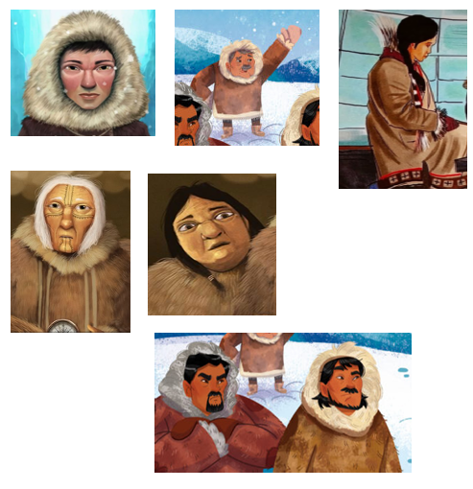
Characters
Keesh- A young Inuit hunter who defies the expectations of his tribe and becomes a great hunter.
Klosh-Kwan- A respected elder in the tribe who opposes Keesh's unconventional hunting methods.
Ikeega- the mother of Keesh.
Klosh Kwan- the chief of the village.
Ugh Gluk- He is portrayed as one of the skeptics who doubts Keesh's ability to provide for the tribe using unconventional hunting methods.
Mawn & Bim- two hunters who spied on Keesh

Slide 3
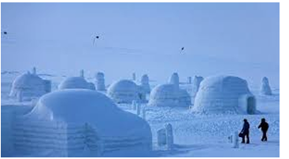
Setting
The story happened in a village of igloos at the rim of the polar sea.

Slide 4
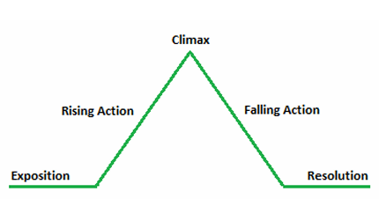
Plot
Exposition- Keesh, a young Inuit hunter living in a remote village, desires to prove his worth and provide for his tribe. Keesh's father and the other hunters in the tribe doubt his ability to hunt dangerous game, such as polar bears, using unconventional methods.
Rising action- Keesh devises a cunning plan to hunt the polar bears, using his intelligence and ingenuity.
Climax- Keesh successfully hunts and kills a polar bear using his intelligence and cunning.
Falling action- Keesh provides food for his tribe and gains the respect of the community.
Resolution- Keesh's triumphant return to the village as a hero and his eventual appointment as the new chief.

Slide 5
Flashback and Foreshadowing
Flashback: A scene set in a time earlier than the main story.
Foreshadowing: Hints or clues about what will happen later in the story.
How does the flashback contribute to your understanding of Keesh’s background?
What events or dialogue foreshadow the council’s eventual recognition of Keesh’s methods?

Slide 6
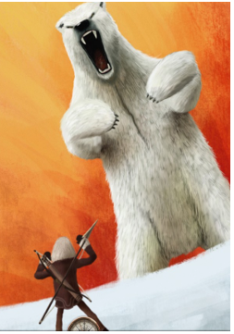
Turn and Talk
▪What is Keesh’s primary challenge in the story?
▪How does Keesh’s character represent the theme of resourcefulness?
▪What does the story teach us about fairness and leadership?

Slide 7
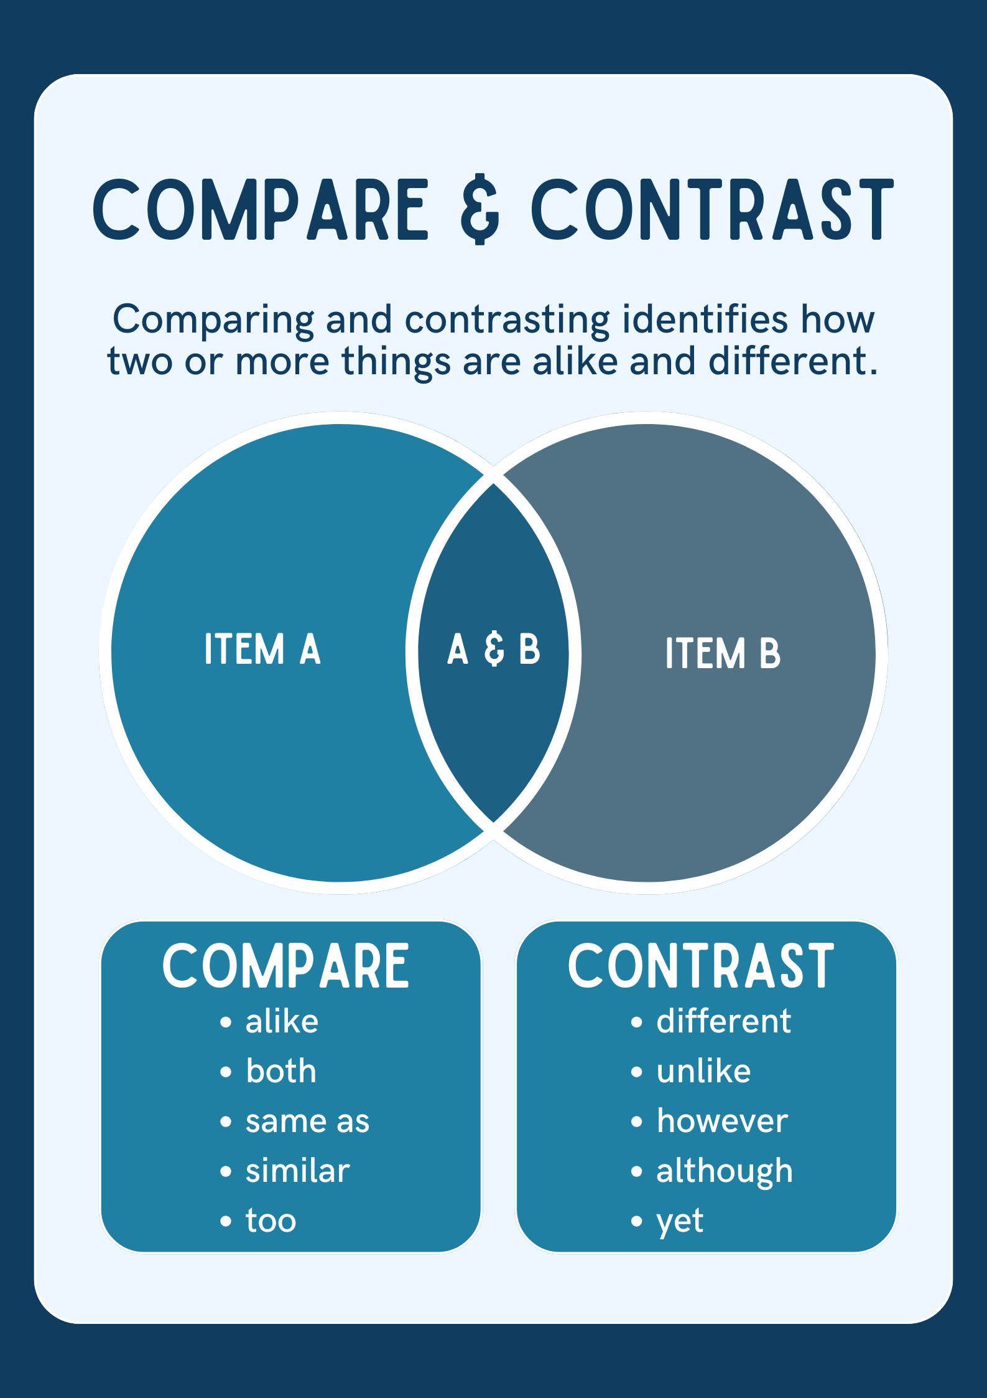
Comparison and Contrast
Comparison = Similarities
Contrast = Differences
How is Keesh’s intelligence contrasted with the physical strength of the hunters?
How does Keesh’s treatment at the beginning of the story compare to his treatment at the end?
Compare the way Keesh and the village elders handle leadership.

Slide 8
Performance Task
Poster Creation
Create a poster illustrating one of the key themes in The Story of Keesh (e.g., intelligence over strength, fairness, or leadership). Use symbolic images, quotes from the story, and a short written explanation to represent the theme.
PODCAST or SPEECH
Record a podcast or deliver a speech discussing how one of the themes is developed in the story. Include examples from the text and your interpretation of the author’s message

Slide 9
Rubrics
Criteria
Understanding of Theme | Theme is thoroughly analyzed with insightful connections to the story. | 5
Use of Evidence | Strong, relevant evidence from the text supports analysis. | 5
Creativity | Highly creative and original representation of the theme. | 5
Presentation/Organization | Work is exceptionally well-organized and clear. | 5
Collaboration | Demonstrates exceptional teamwork and participation. | 5
TOTAL |  | 25

